Slide 1
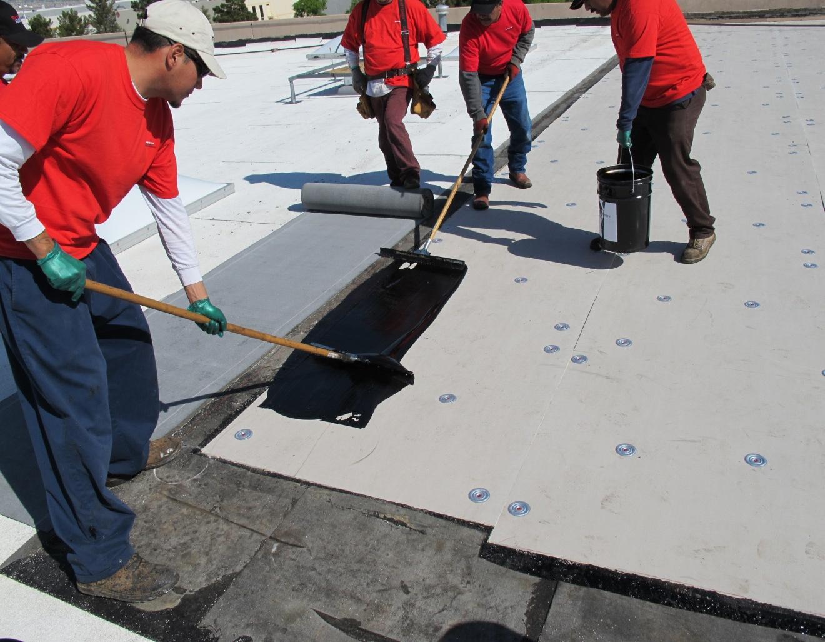
LiquiGard™
Firestone Building Products

Slide 2
LiquiGard™
About
Firestone LiquiGard™ is a tough, liquid applied, two-part polyurethane adhesive. It forms a superior bond with approved Firestone insulation and with SBS and BUR products.
Great for bonding multiple layers of membrane and approved Firestone insulation.
No Odor and Zero VOC’s makes it great for use on schools, hospitals, and occupied buildings.
LiquiGard™ Part B activator is an amber colored liquid component which initiates a chemical cure when blended with LiquiGard™ Part A. This is not a catalyst and must be mixed in proper ratios.
For use with Firestone SBS Modified Bitumen, BUR and Polyiso roofing systems. Application is recommended for membrane attachment to both horizontal and vertical surfaces.
LiquiGard™ adheres aggressively to concrete, steel, Firestone polyiso, other approved insulations and most construction materials. Surfaces must be clean and dry.

Slide 3
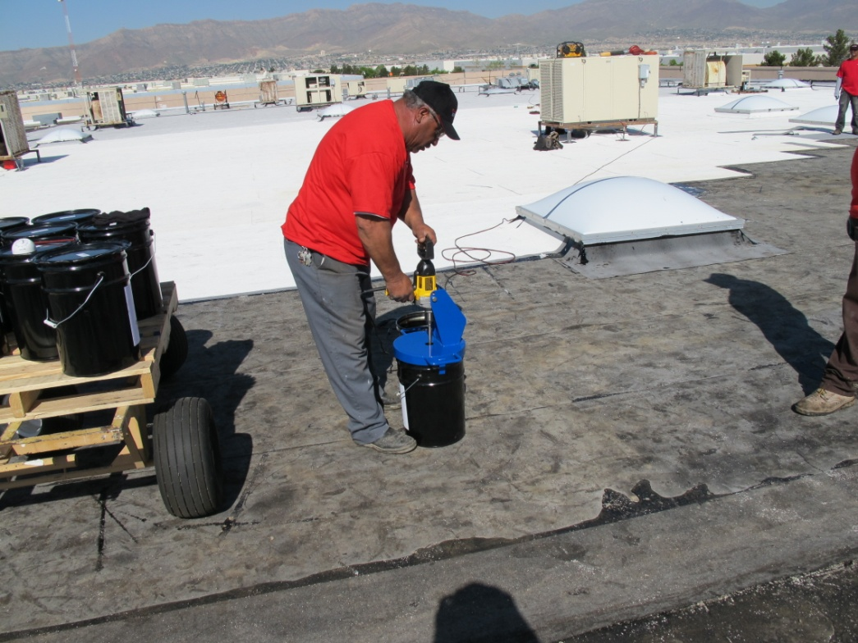
LiquiGard™
Mixing
Mix Part A and Part B with an 8” mud blade for a minimum of 3 minutes.
Do not mix partial containers.
Do not mix by hand.
LiquiGard™ should be at least 60°F when mixed and applied.

Slide 4
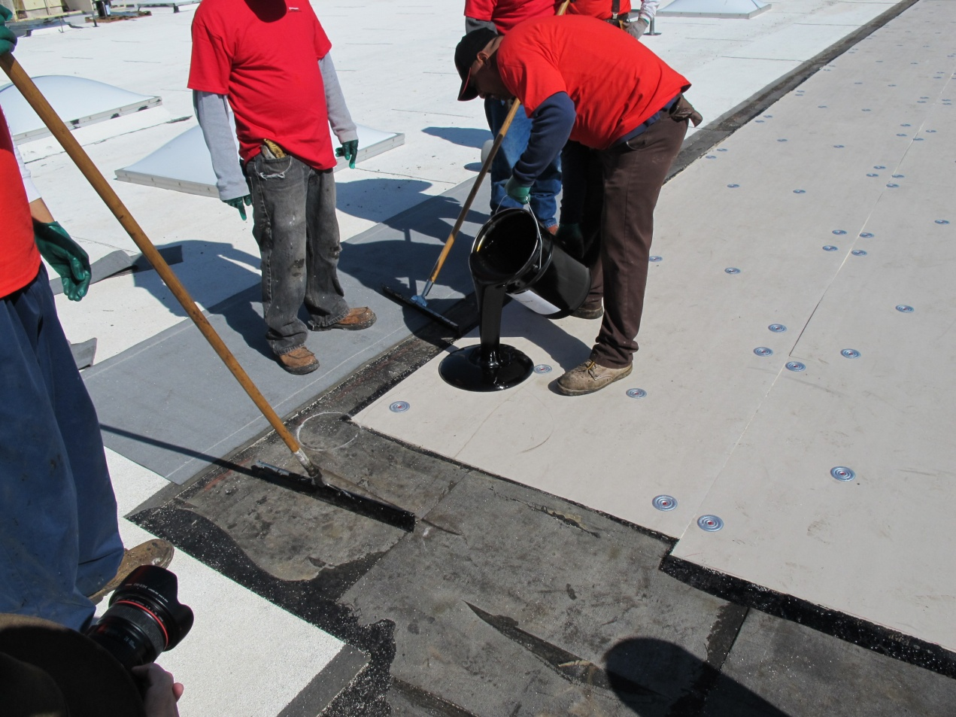
LiquiGard™
Application
Ensure that substrates are clean, dry, smooth, and free of sharp edges or other contaminants.
Ambient and substrate temperatures during application should be 45° and rising.
All material should be applied within 30 minutes after mixing. Warmer temperatures reduce the working time.

Slide 5
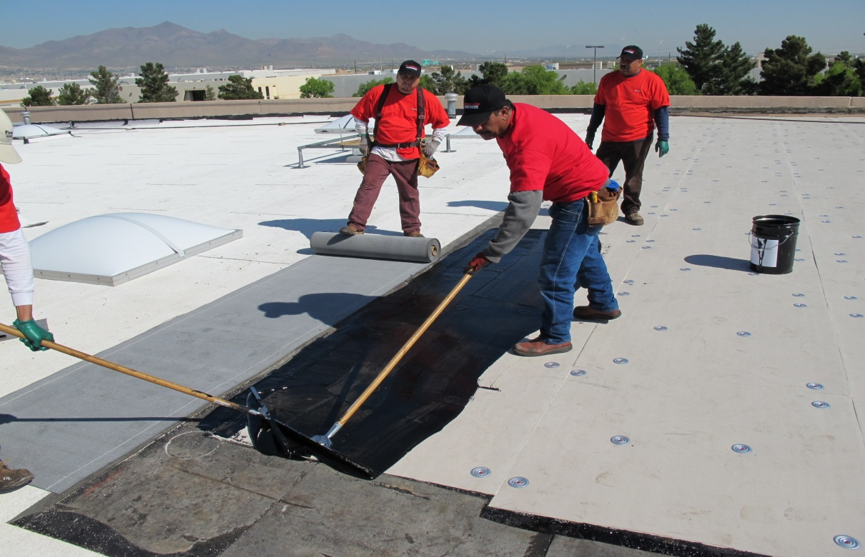
LiquiGard™
Application
For membranes, apply LiquiGard™ in full coverage using a ¼” notched squeegee. Trowels can be used for adhering flashings and other small applications.
Polyiso insulation is adhered in a continuous layer of LiquiGard™.

Slide 6
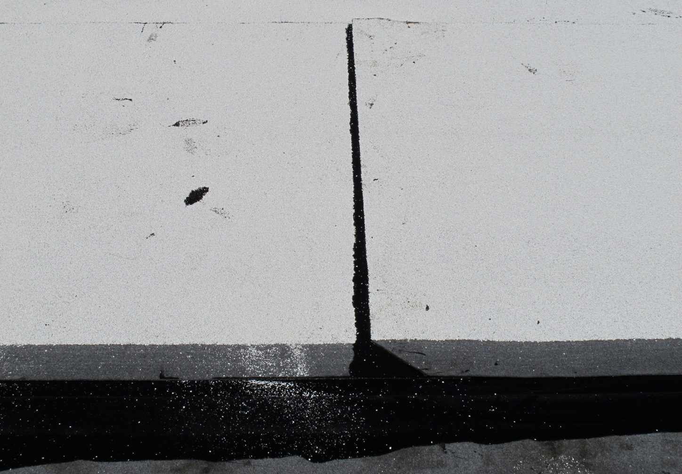
LiquiGard™
Application
Allow for some bleed out at the side and end laps to ensure that the laps are properly sealed.

Slide 7
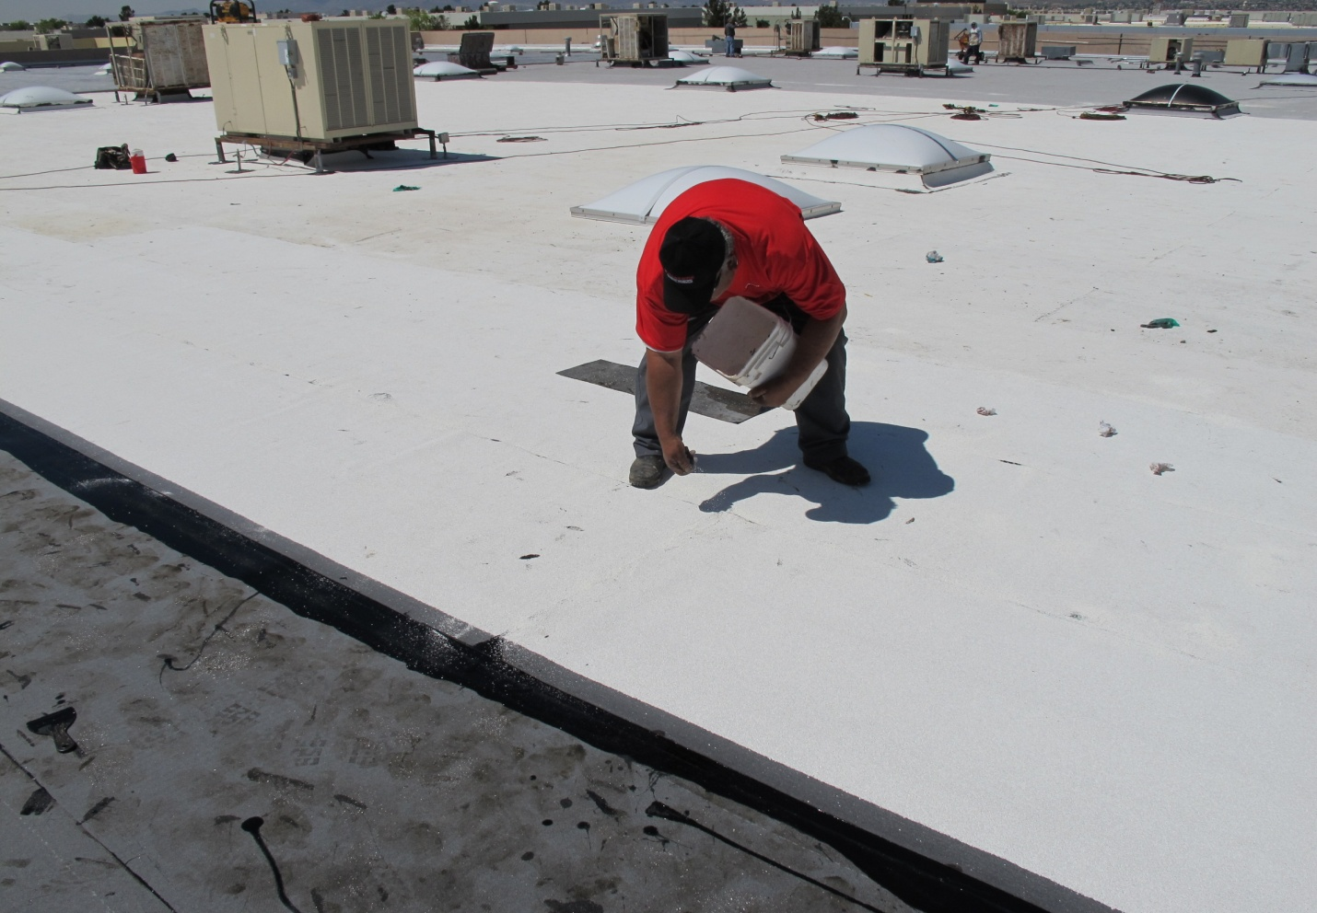
LiquiGard™
Application
Casting granules into the exposed LiquiGard™ is an option that offers a clean, finished look.

Slide 8
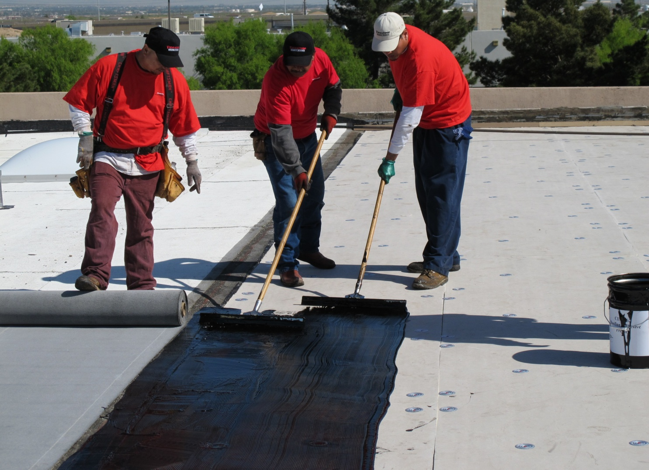
LiquiGard™
For more technical information and updates regarding LiquiGard™ Adhesive visit www.firestonebpco.com

